Slide 1
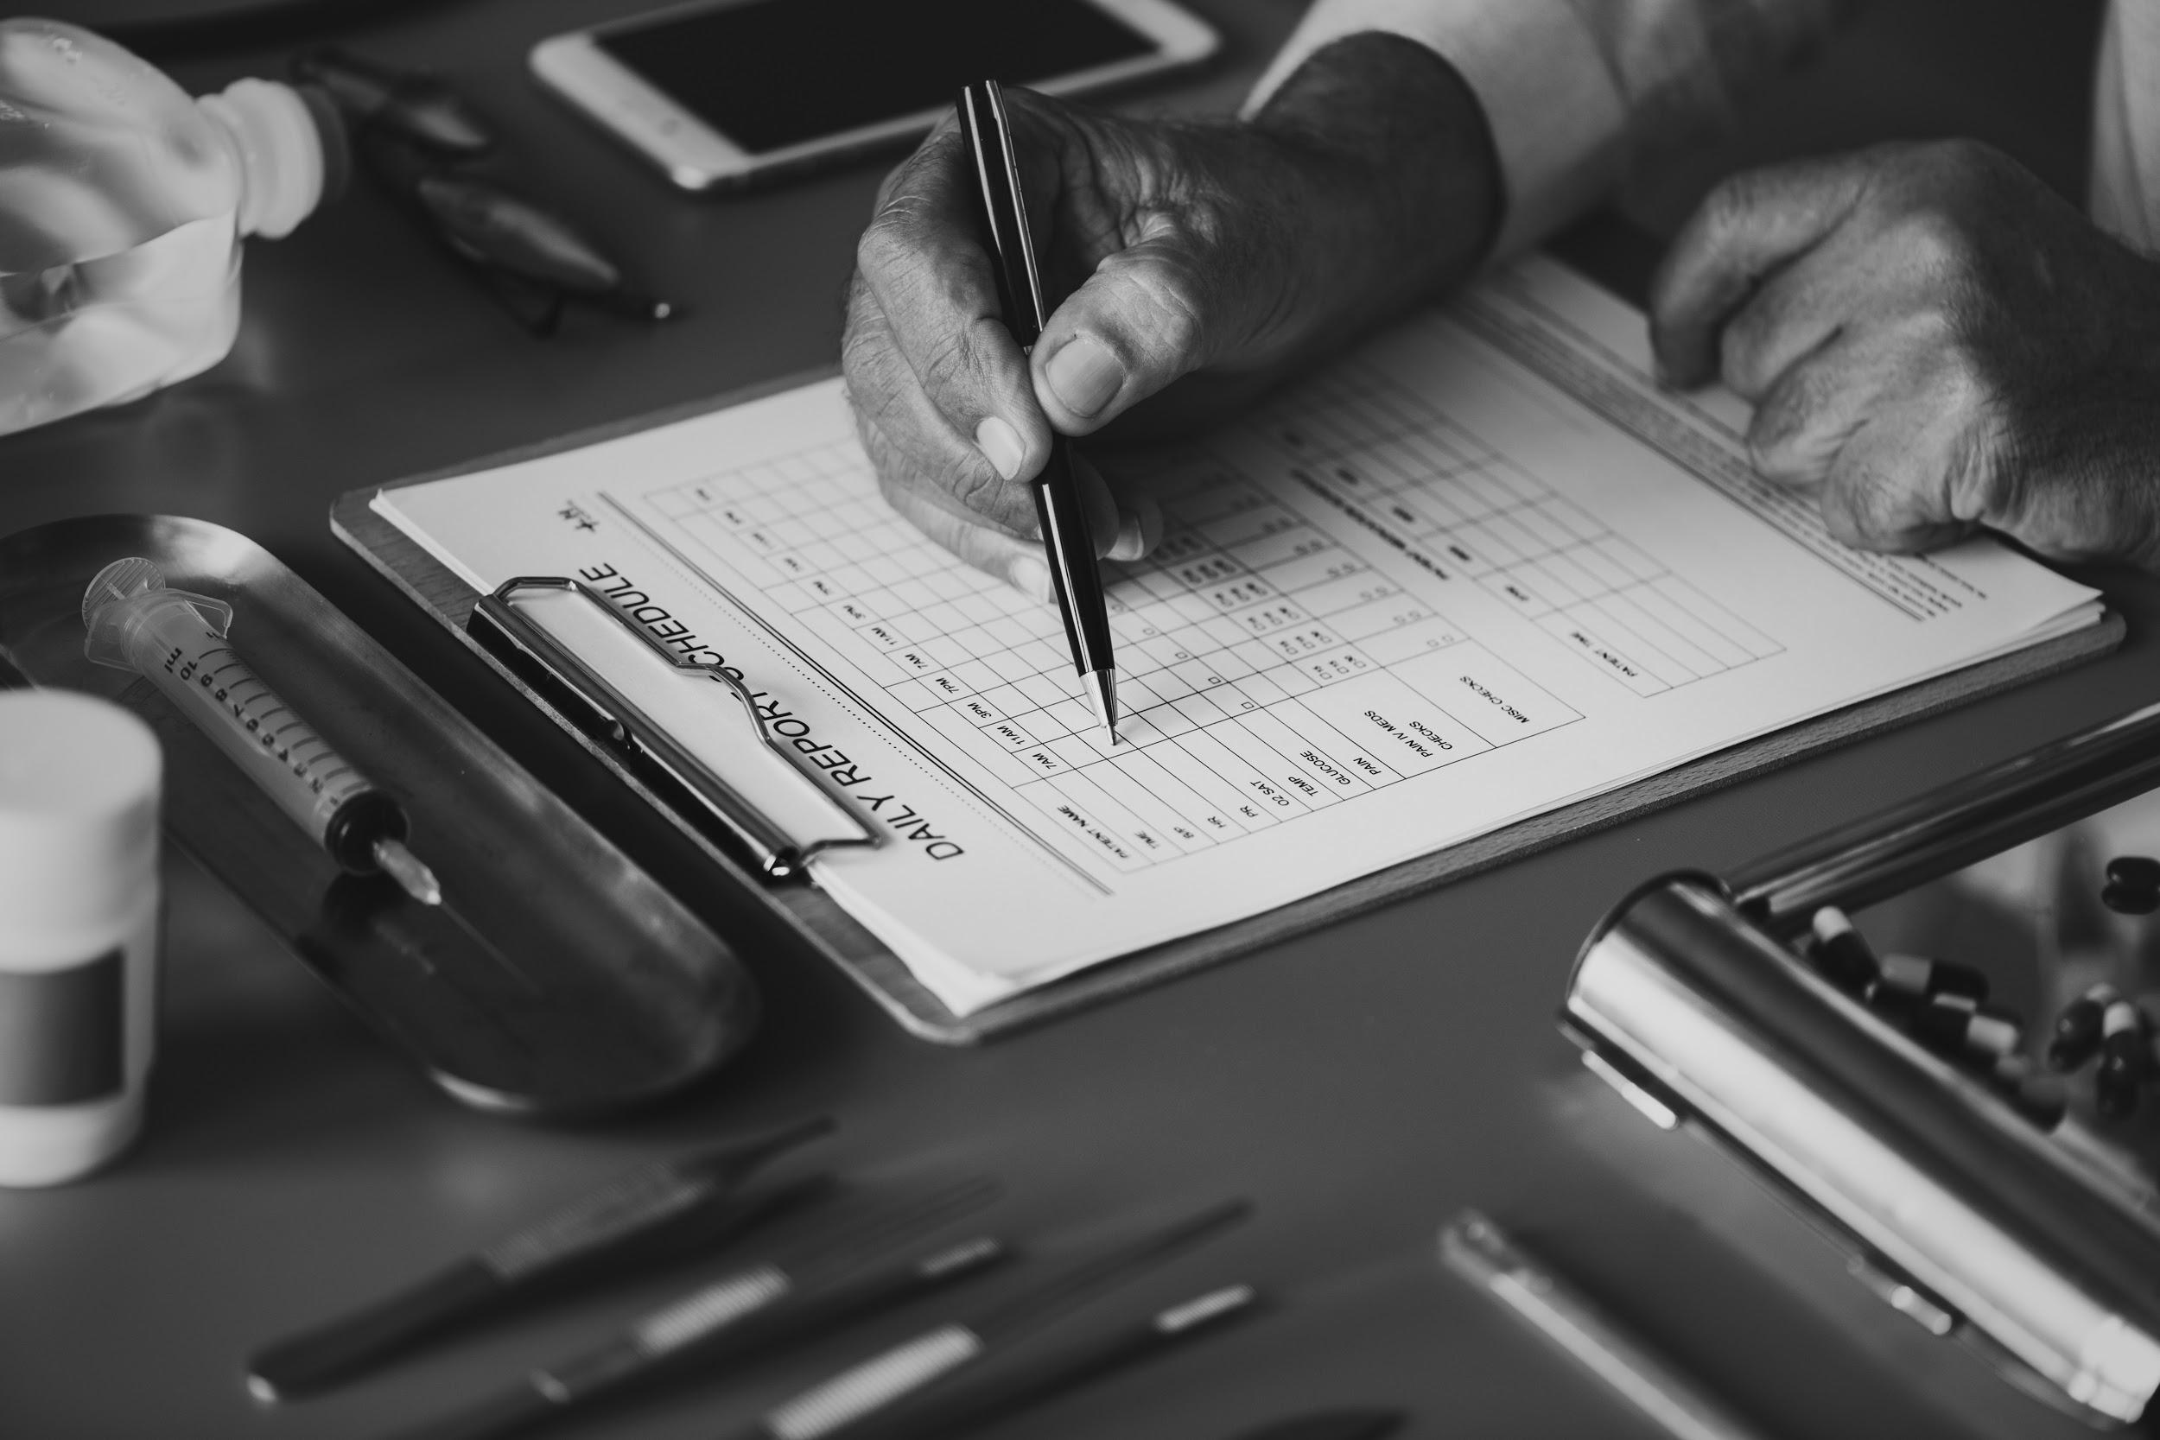
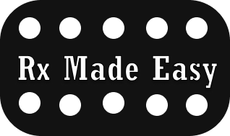
Track and manage your medication with just a couple of clicks.
User researcher: Betelehem Abebe
Tools used: Invision, Miro, and Figma

Slide 2
Problem
Solution
People have trouble managing their prescription medications.
Rx Made Easy is an app that would help people track their medication. This app will have a search tool to find near pharmacys where the user can set up an account and track every medication prescribed along with refills and pick up.

Slide 3
Interview
The interviews conducted brought in perspective that was necessary to kept in mind when building this app.
Some key point my team I found in our interviews was that people did not go out of their way to compare prices for their medication.
They also chose their pharmacy location based on convinces and insurance coverage.
Although some were aware of the price discrepancies between pharmacys many did not take the initiative to take advantage.
Our team conducted a total of 6 interviews. In those interviews we hoped to find common struggles that people faced when it comes to prescription management.
Interview Questions

Slide 4
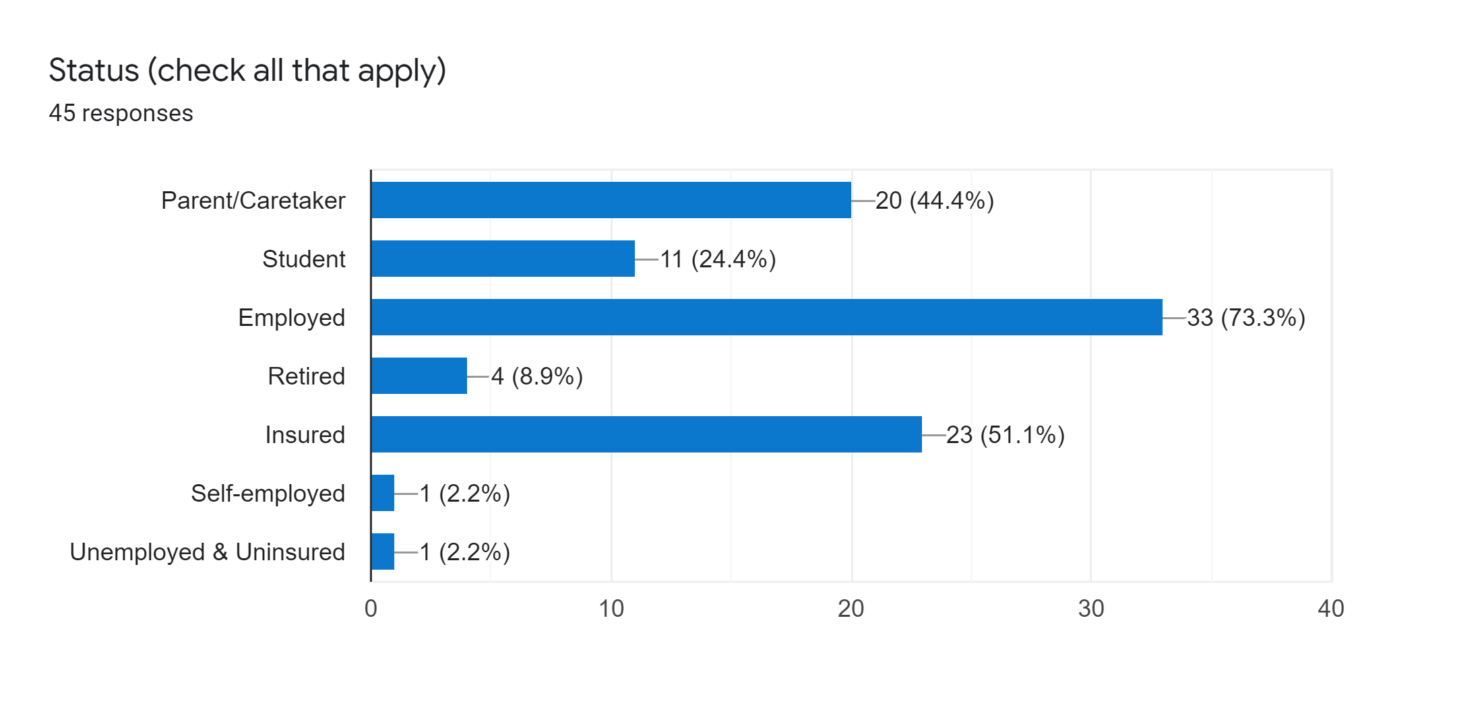
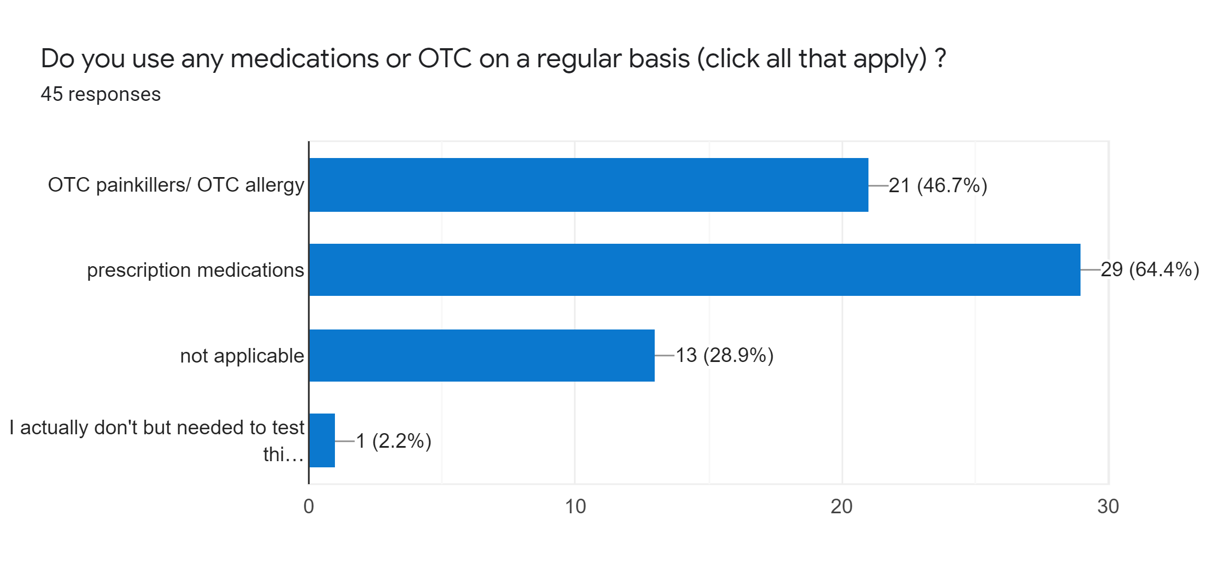
Survey
Here are some of the Survey findings.
There is a total of 45 participants, and 88% of them have used between 1-3 pharmacy to get their medication for that past year.
48.9% claimed that their medication takes more than 5 hours but less than a day to be prepared for pick up
73.3 % are employed and 51.1% are insured
64.4% take prescription medication
Quote from Survey
“My insurance generally dictates my prescription purchasing habits.”
Survey Data

Slide 5
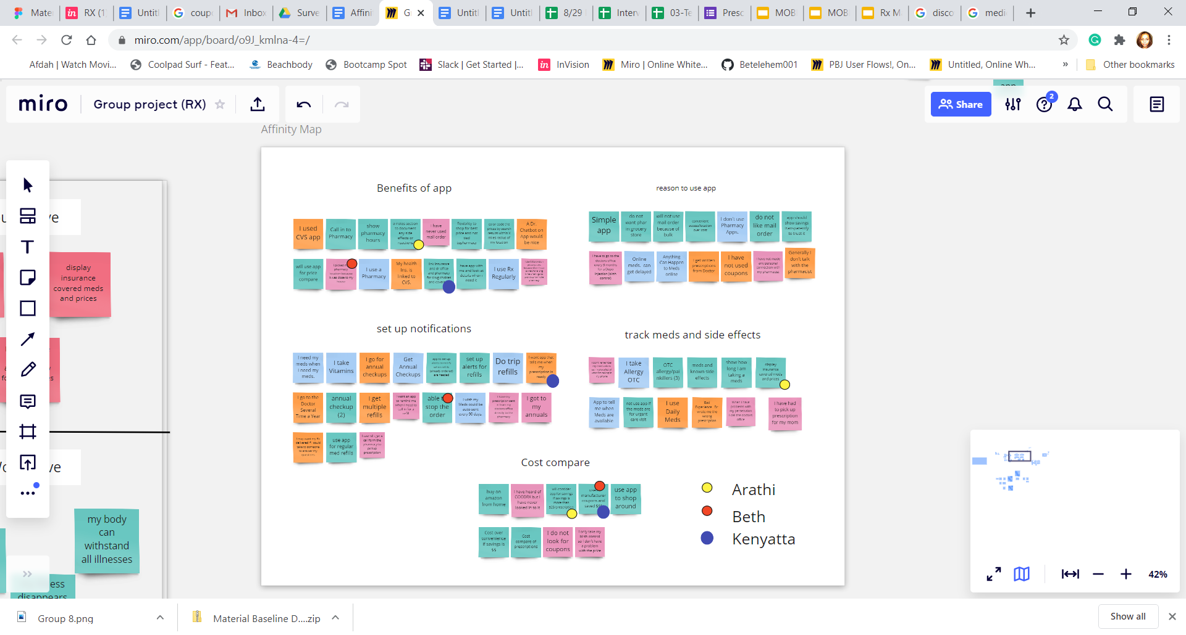
Affinity Diagram
From our interviews we gather up some data that helped us find some key points that a user would find useful.
Easy access to coupons
Notifications for pick up time
Proximity search to pharmacy locations
Cost compare
Affinity Diagram

Slide 6
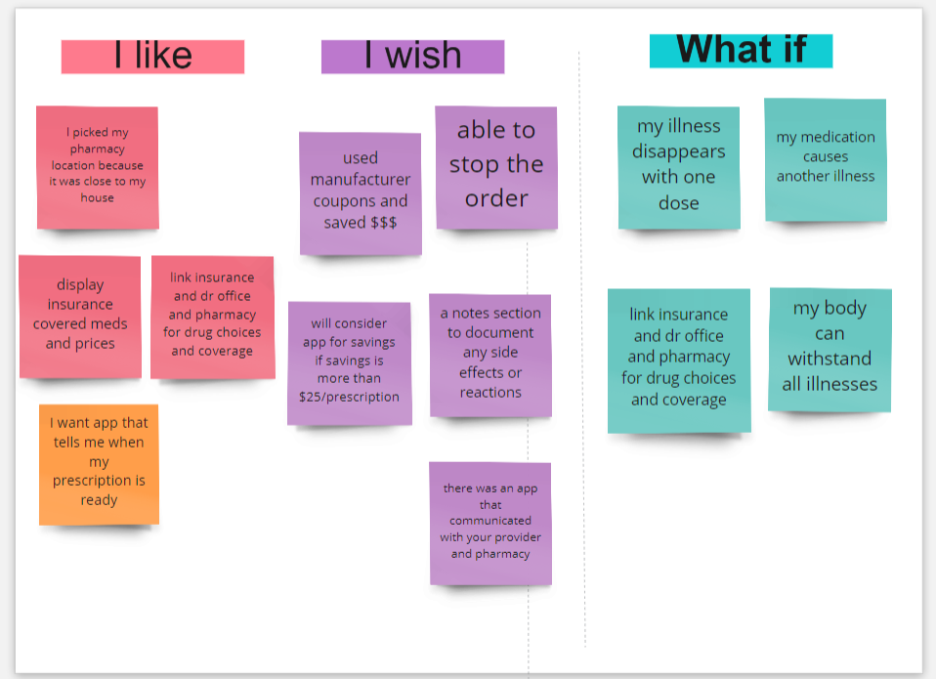
I Like, I Wish, What If
Using the dissected affinity map which organized the findings from the interview and survey. The I like, I wish, and What if template was used to further investigate solution concepts.
App needs to communicate effectively with users choice of pharmacy
App needs to organize price comparison features

Slide 7
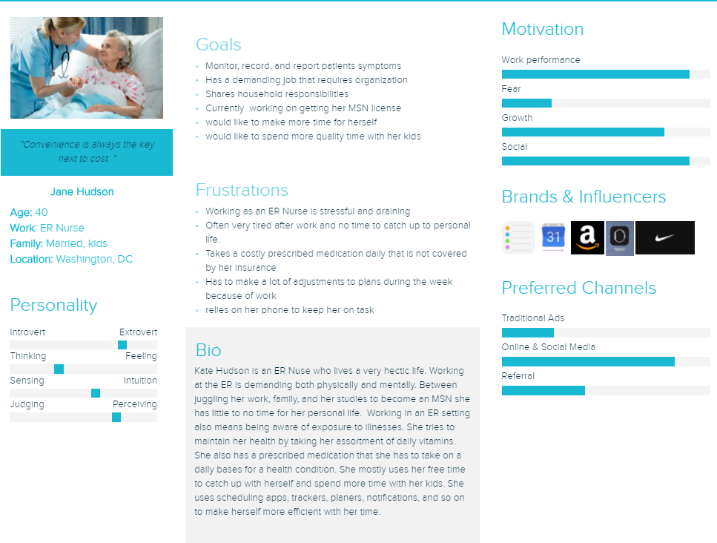
User Persona

Slide 8
User Insight
Jane is frustrated with the her prescription medication not being available for pick up. Jane relies on her medications as she takes most of them daily. She needs the pharmacy to have her refills ready in a timely fashion so she doesn’t skip any of her q.d prescription med’s.

Slide 9
Problem Statement
Coordinating prescription refills and searching for medication cost savings is a time-consuming process for users. Not having health insurance coverage adds to the complexity and frustration.
How might we help users coordinate their prescription refills, and provide them with cost savings?

Slide 10
Ideation
The design for this app is centered around providing servers. I want to make performing a task for a users as straightforward as possible.
I will use icons that are universal along with text guides.
I will have leading texts in search boxes to help user navigate more efficiently.
Bolded letters and outlined text boxes
Color variation for texts that are action oriented

Slide 11
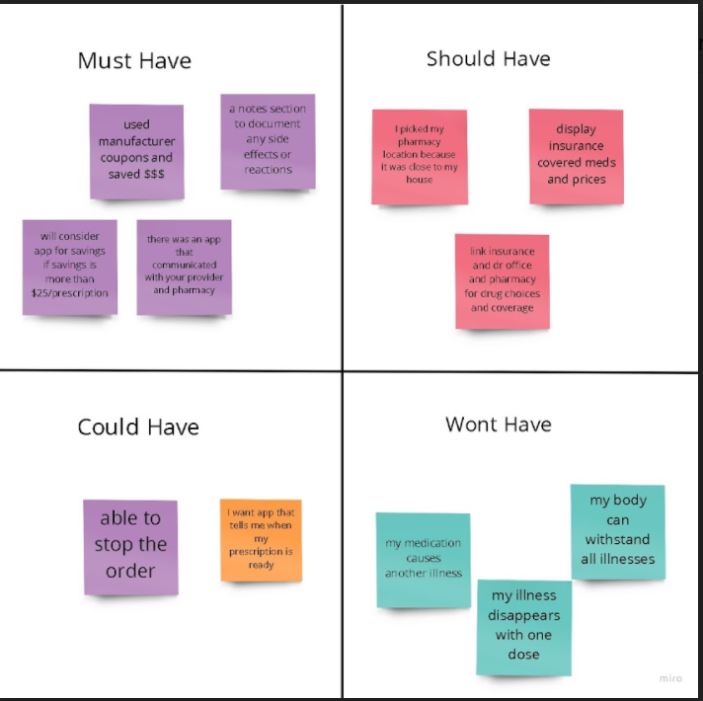
Feature Prioritization Matrix
To prioritize product features, and avoid featuritis I conducted a MoSCoW analysis.
Display insurance covered meds and prices
Notification for pick up
Refill options for medications
Keep track of medications

Slide 12
Value Proposition
Track and manage your medication with just a couple of clicks.

Slide 13
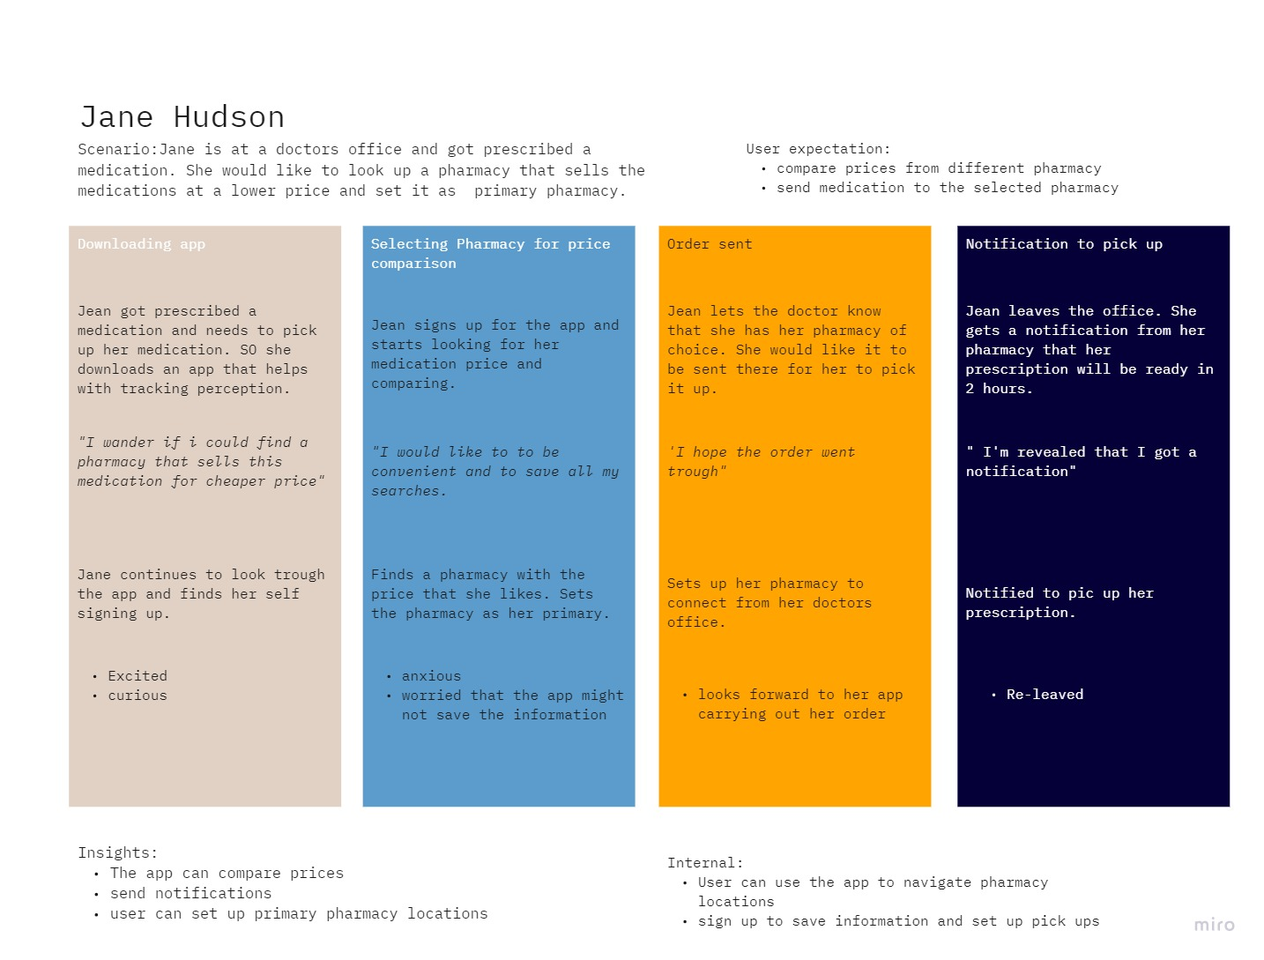
User Journey Map
User Journey map

Slide 14
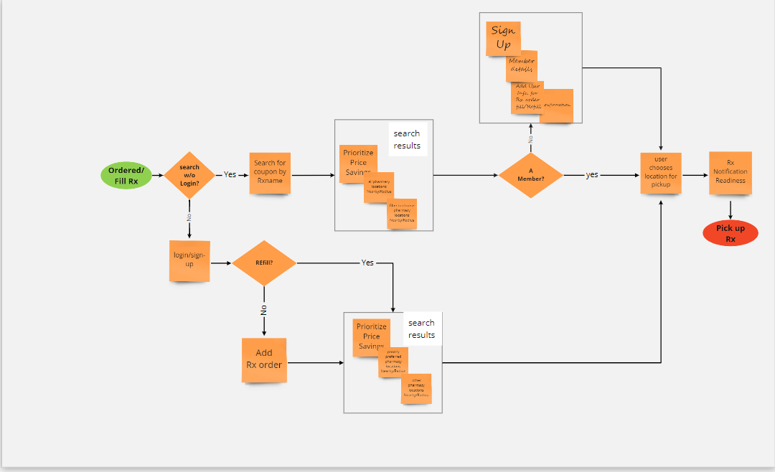
User Flow
User Flow

Slide 15
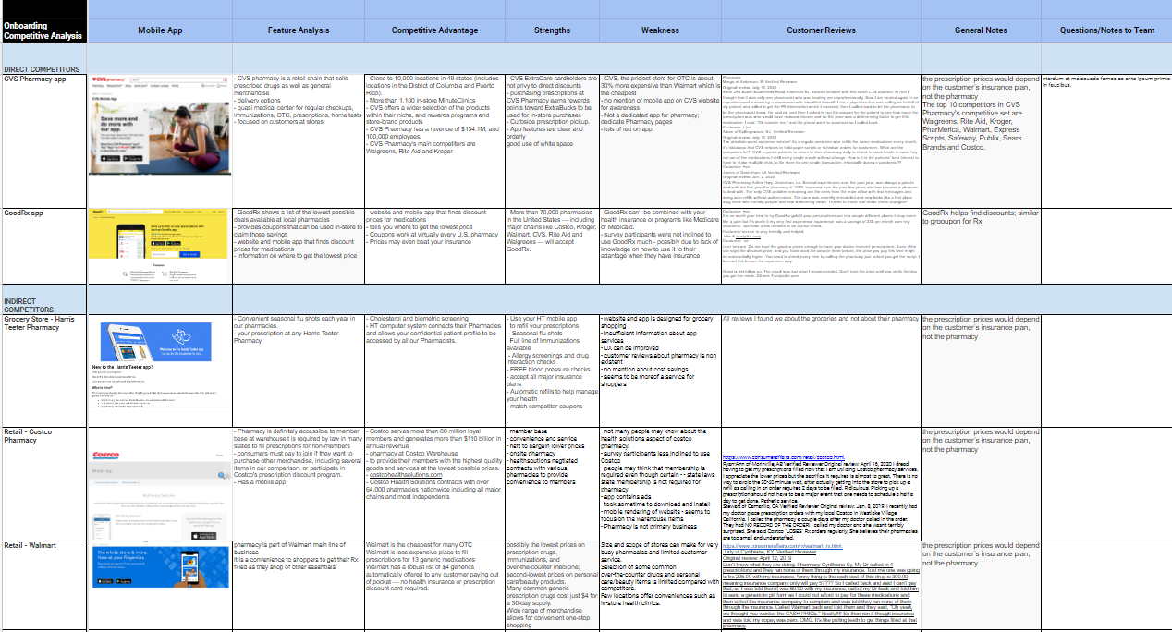


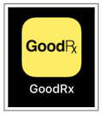
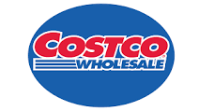
Competitive Analysis

Slide 16
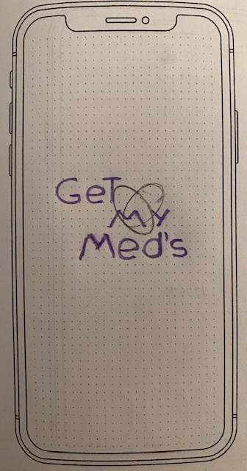
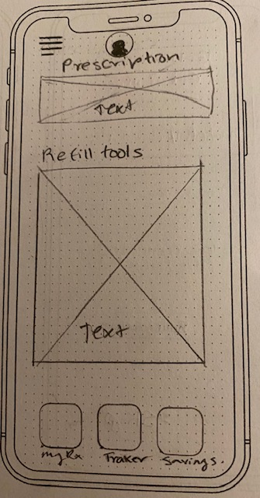
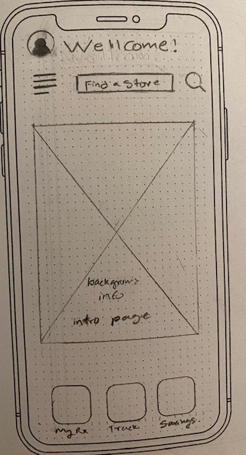
Sketches
First round of Sketches
Formed a basic outline of the app with login page, welcome page, and the outline page for the icons that are going to help user complete task.
Get My Med’s was a great name for the app but as I started to look for more inspiration apps to build my prototype I found this app already exists under that name.
Got feedback on the outlook of the app and icon.
Found a new inspo and started over again on figma.

Slide 17
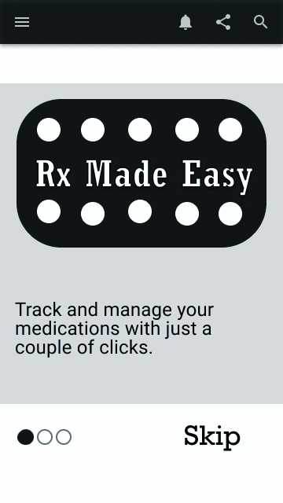
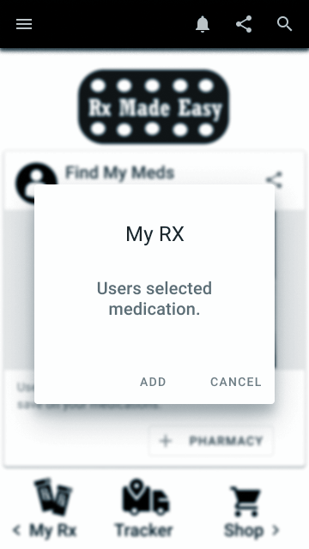
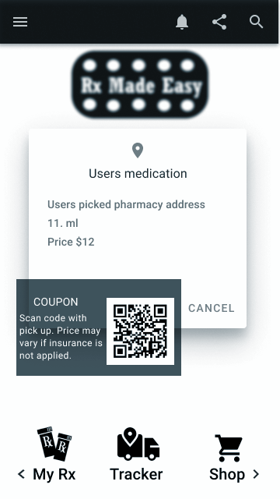
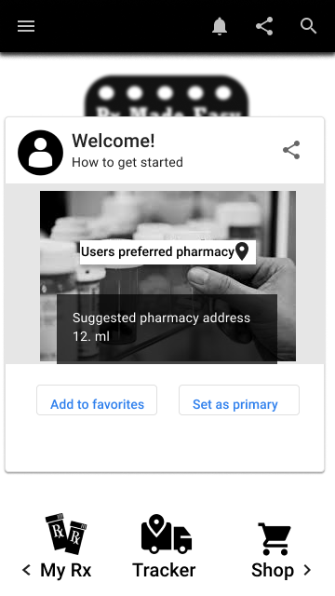
Digital Wireframes
The app name was changed from Get My Meds to Rx Made Easy.
Icon saving was changing to shop where the user can look up medications and coupons
My Rx will contain users medications along with the amount of refills left
Tracker app will allow users get notified when medication is ready for pick up
Rx Made Easy

Slide 18
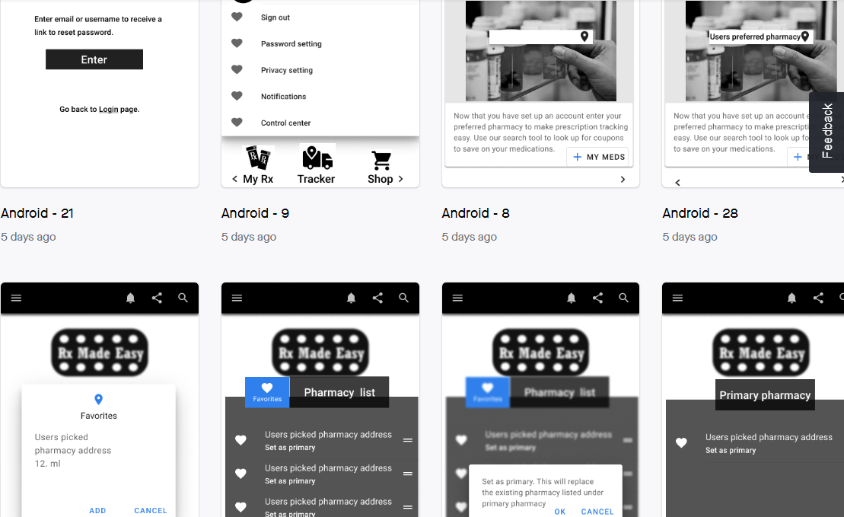
Hi-Fi InVision Prototype
InVision Prototype

Slide 19
2 Recorded User Tests
User tester 1:
Kaylie Tesome
24
Workers for the government
Has insurance
Has had multiple experiences with prescription management but does not take prescribed medication on a daily
User tester 2:
Kelsey Jones
25
Works in HR Has insurance
Has had multiple experiences with prescription management but does take prescribed medication on a daily and has to deal with refill complications.
Usability test recordings

Slide 20
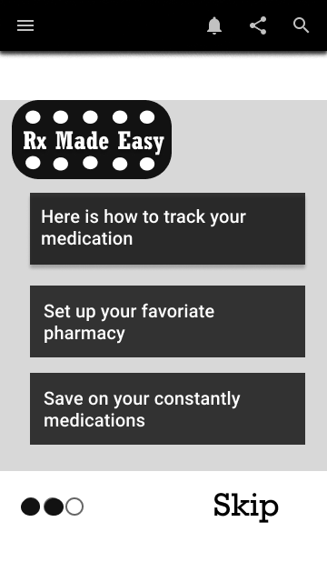
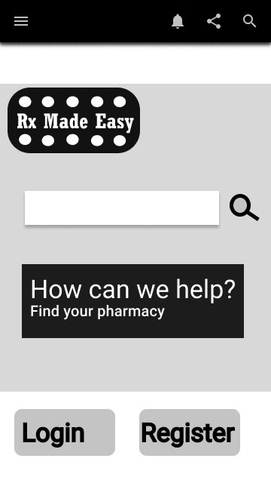
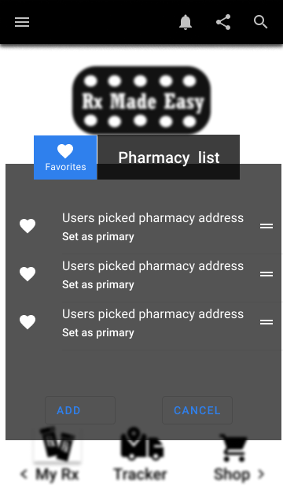
Key Learning from User Test
Dummy texts are very important and needed to be clarified in search bars
Icon tools that lead to main pages need to be accessible
Redundant pages that double confirm actions can be more confusing
A feature to go back after a task is completed needs to be added
Action keays need to be bold
Background layout needs to be less distracting to texts
Introduction page was misleading with information bars that look clickable or may lead to another page for more information

Slide 21
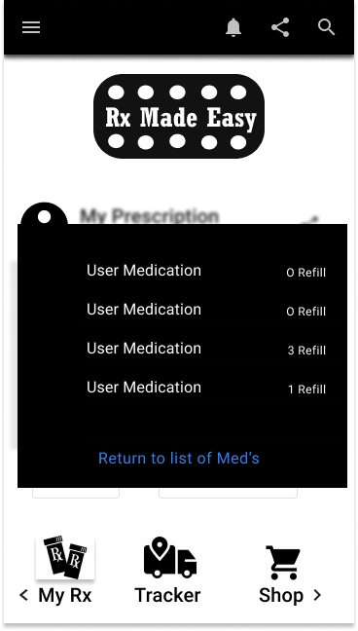
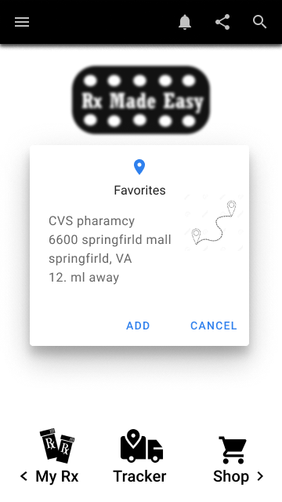
Iterations Made Based on User Test
Solid backgrounds for better visual
Dummy testes in search bars
Added locations to paint a better user experience
Defined action icons
Bolded and colored text for legibility
Clear and concise texts
Iterations made to frames

Slide 22
Guerilla Testing Plan & Notes
Guerilla testing are done through zoom
I made sure that the user testers have had experiences with managing prescriptions
Users are encouraged to use complete tasks to their best judgement and ask questions
Feed backs and speaking through thought process is encouraged
Guerrilla Testing Plan & Notes

Slide 23
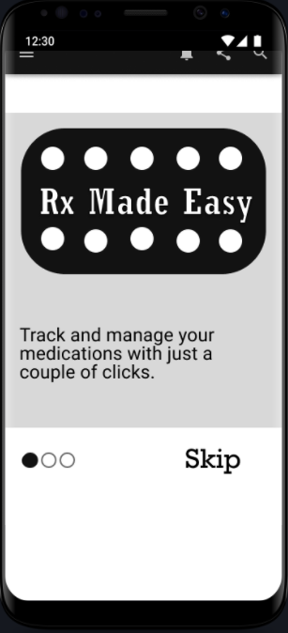
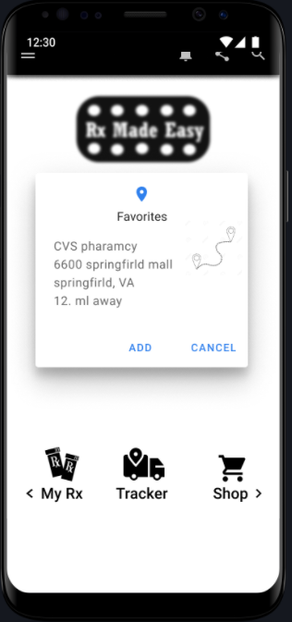
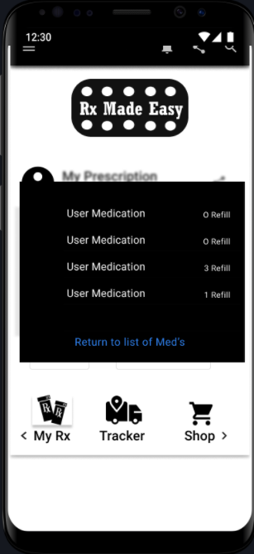
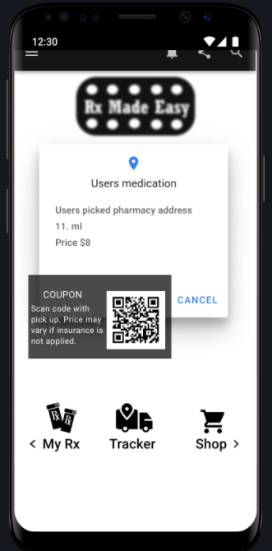
iOS Prototype

Slide 24
Final Thoughts / Conclusion
Over all this project was intuitive and challenging in rewarding ways. This project sparked great conversation with my group and I. We discussed our finding and how to organize key features. We discussed our own opinions and shared research findings. I’m pleased with our work and had a great time sharing ideas.
Group folder

